Slide 1
NOVA
Group 12
Michael Cole
mcole3@mix.wvu.edu
Steve Williams
swilli12@mix.wvu.edu

Slide 2
ISAMP

Slide 3
Features
Completely random
Not complete
Requires only enough RAM to hold one (or two) solution(s)
Very fast
Solution quality affected by size of search space

Slide 4
Algorithm
for i := 1 to MAX TRIES {
try:
set all variables to unassigned
loop {
if all variables are valued
then return current assignment
else {
v <-- random unvalued variable
assign v a randomly chosen value
unit_propagate()
if contradiction goto try
}
}
}
return failure
http://menzies.us/csx72/?search

Slide 5
Results Comparison

Slide 6
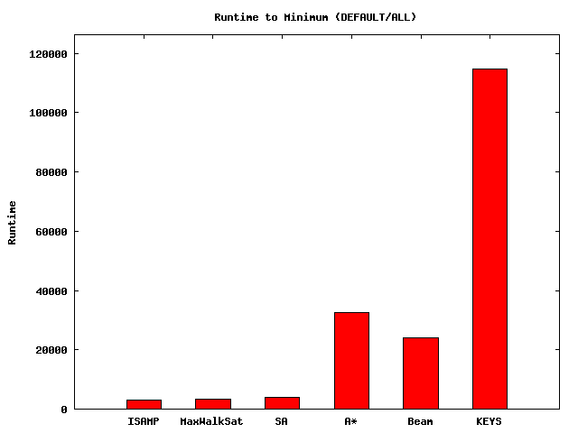
Runtime to Minimum

Slide 7
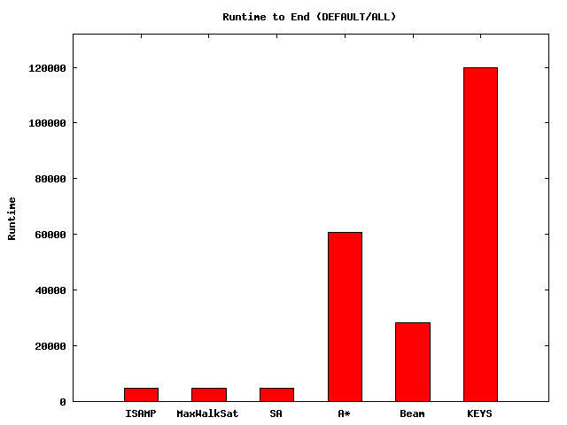
Runtime to End

Slide 8
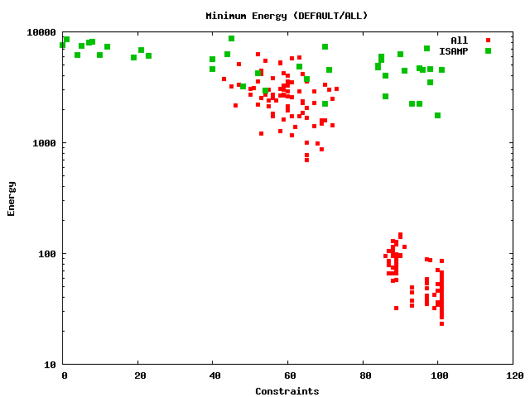
ISAMP

Slide 9
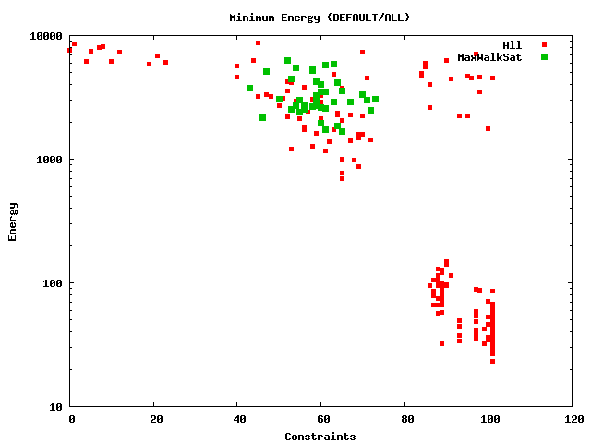
MaxWalkSat

Slide 10
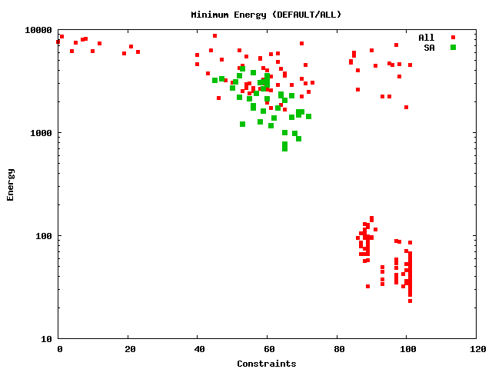
Simulated Annealing

Slide 11
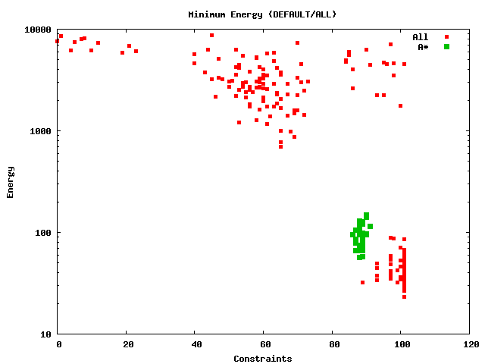
A*

Slide 12
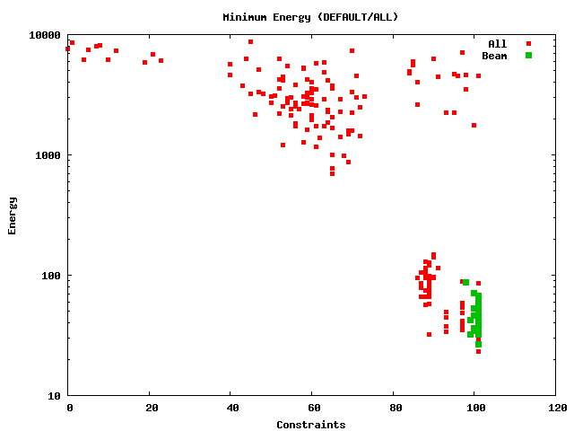
Beam

Slide 13
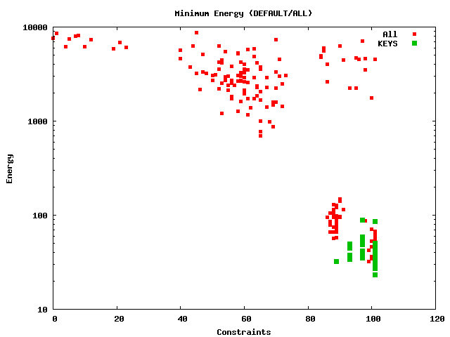
KEYS

Slide 14
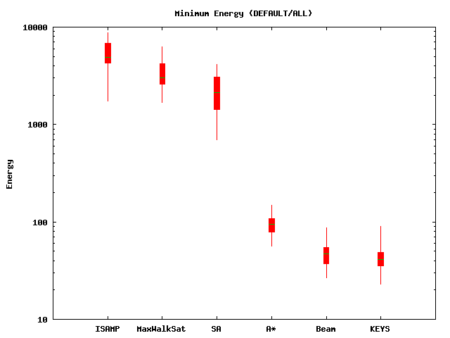
Engine Comparison

Slide 15
Statistical Comparison
Mann-Whitney Test
Engine | Wins | Losses | Ties
KEYS | 4 | 0 | 1
Beam | 4 | 0 | 1
A* | 3 | 2 | 0
SA | 2 | 3 | 0
MaxWalkSat | 1 | 4 | 0
ISAMP | 0 | 5 | 0

Slide 16
Energy Reduction / Constraint
Engine | Reduction
SA | 133
MaxWalkSat | 132
A* | 115
KEYS | 110
BEAM | 105
ISAMP | 85

