Slide 1
Selecting Quality Data
Tim Menzies (Ph.D. )
Assoc Prof; LCSEE, WVU
tim@menzies.us
304-376-2859

Slide 2
Open issues in data quality
(for software engineering)
Conclusion Instability
Locality
Best way to find significant data
  How to import data from other sites
  Relevancy filtering
  Feature selection

Slide 3
Background

Slide 4
The PROMISE Experiment
2005, … 2011
  Repeatable, improvable, maybe even refutable experiments in software engineering
  Put up or shut up
  [Menzies07]
If you publish a paper, it is strong encouraged that you also offer the data on which the conclusion was made
130 data sets:
  Defect prediction
  Effort estimation
  Model-based reasoning
  Text mining
  etc

Slide 5
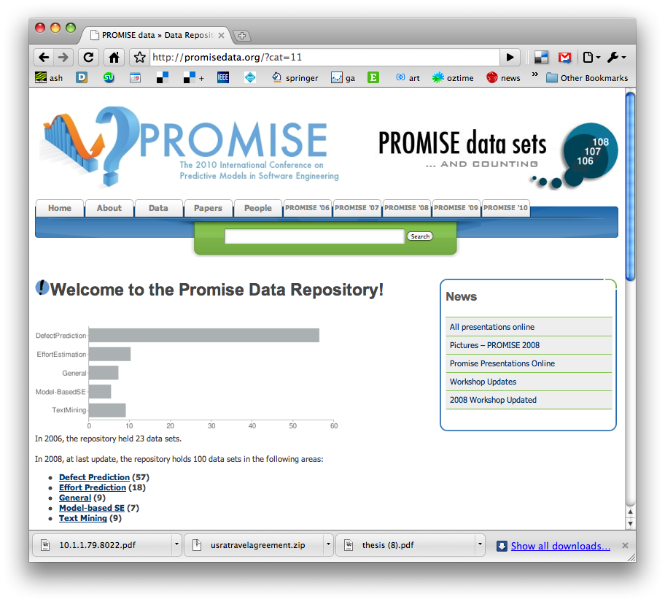
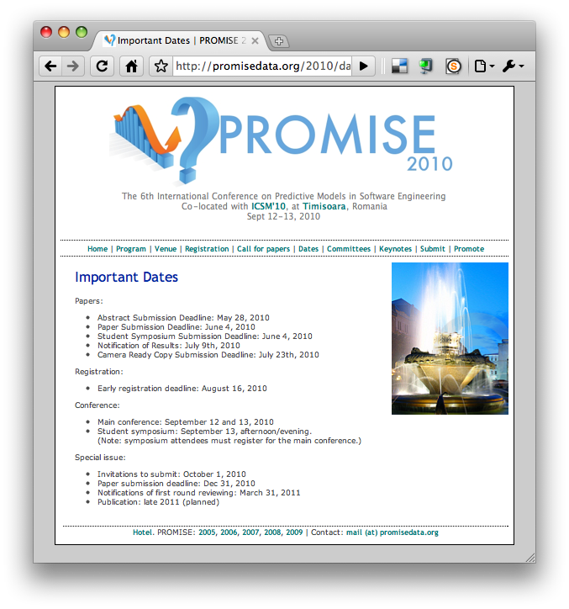
http://promisedata.org/data
Repository +
Annual conference +
Journal special issues
See you there?

Slide 6
Relevance to quality
Other repos
Our repo
Extensive software support for the data storage
  E.g. [Gentleman07, Leisch02]
Elaborate design of research questions:
  E.g. CeBASE [Basili02]
None of those SE repos are still on-line
No restrictions on research questions
Send us something,
  We’ll place it on-line
Let many groups analyzing that data
  Extensive list of conclusions
Still an active, on-going research initiative.

Slide 7
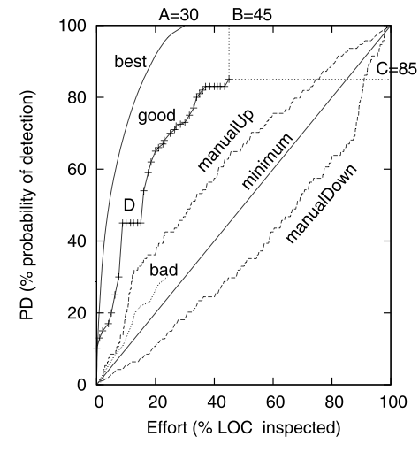
Some results:
Learning to Organize Testing
Inspect X% of the code, find Y% of the bugs
  But which X%?
  Ask a data miner
Typical results:
  [Ostrand10]: X= 20% of files , Y= 75 to 93%
  [Tosun10] : X= 25% . Y= 88%
  [Menzies10a] X= 25%, Y= 70%
    Or any other point you like

Slide 8
Conclusion Instability

Slide 9
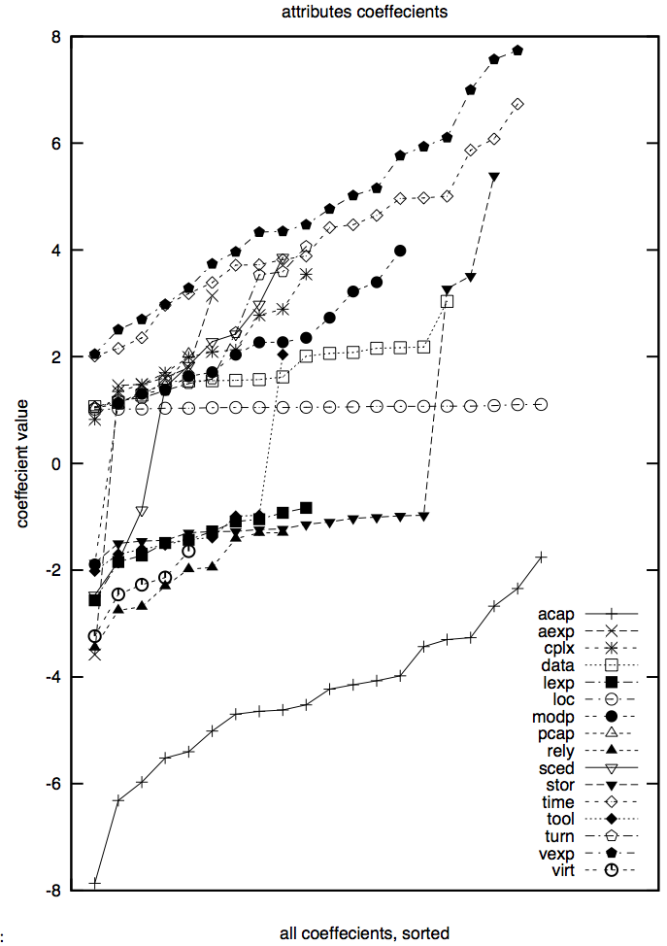
20 * 90% sub-samples
Linear regression on COCOMO data
Wild variance in the learned model
  Specifically, in the variable coefficients

Slide 10
Locality

Slide 11
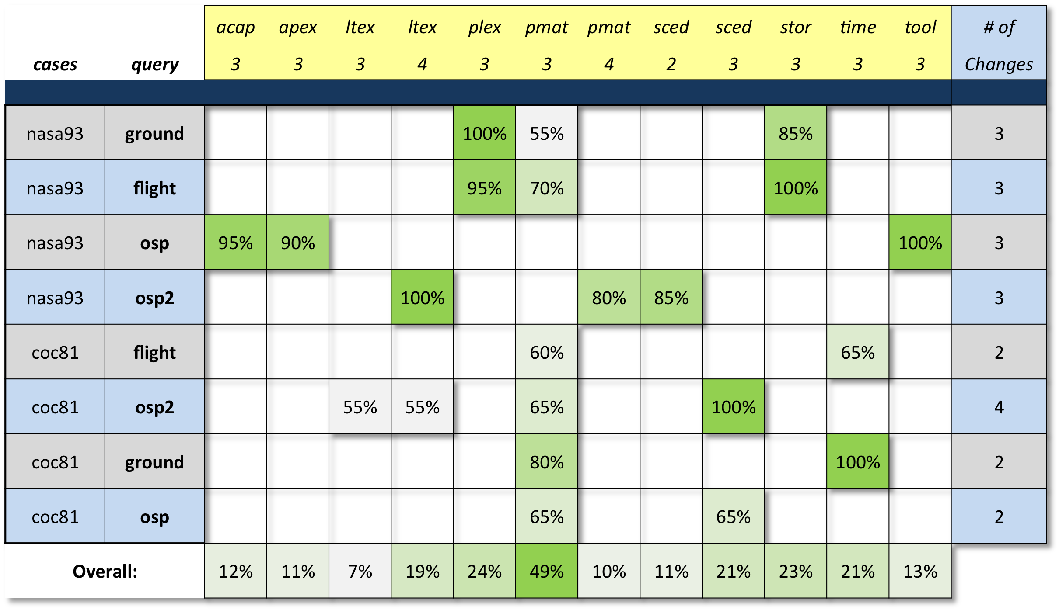
[Brady10]: case-based reasoning to tame instability
Seek best changes to a project
  Tames conclusion instability, but conclusions project specific
Beware the snake
oil salesman telling
you that “it worked
there, it will work
here”
Best to assess
policies w.r.t.
local data
(Are you
collecting
local data?)

Slide 12
How to find significant data

Slide 13

Some data is better than others
Relevancy filtering
  Given a test set T
  Relevant = the k-th nearest
  neighbors in the train set
  Only train on this “relevant” set
Data subset selection
  Reveal the core content

Slide 14
Relevancy filtering:
How to use other people’s data
Learning
  (a) software development estimation or
  (b) software defect predictors
Suppose you don’t have local data
  Find relevant data from other companies
Works as well as if you had local data
  For defect prediction [Turhan09]
  For effort estimation [Menzies10]
An experiment with N contractors
  Imported:
    train on them, test on me
  Local:
    train on one, test of one
  Relevant:
    find nearest neighbors in them, train on just those
    test on me
Pd = detection, pf = false alarm
  Imported pd,pf = 94 (!) , 68
  Local: pd,pf = 75,29
  Rlevant: pd,pf = 69,27

Slide 15
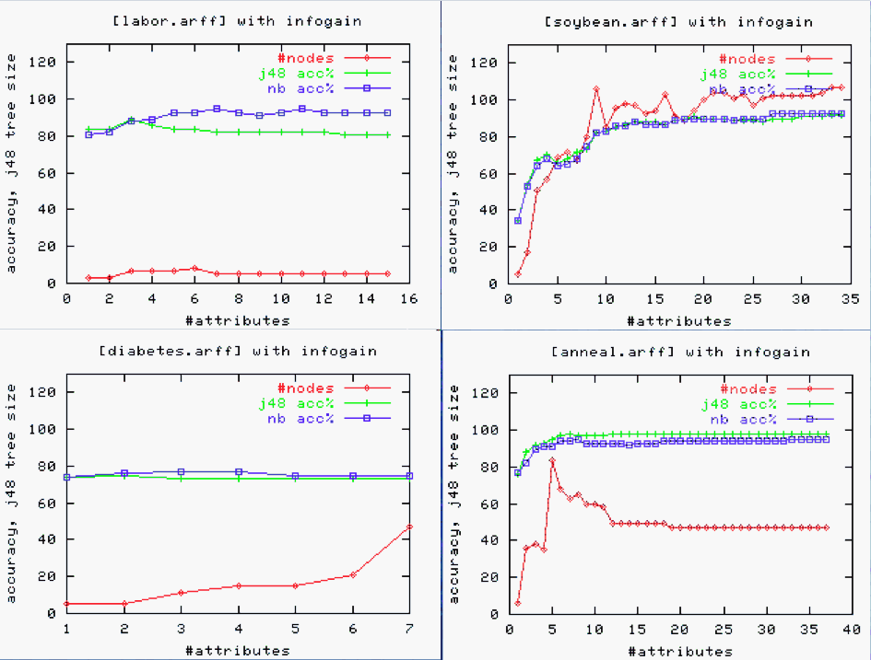
Feature selection: strip away spurious details
X-axis
sorted by entropy
sum(-p*log(p))
Useful = 6/16, 10/35, 1/7, 5/45 = 38%, 26%, 14%, 11%

Slide 16
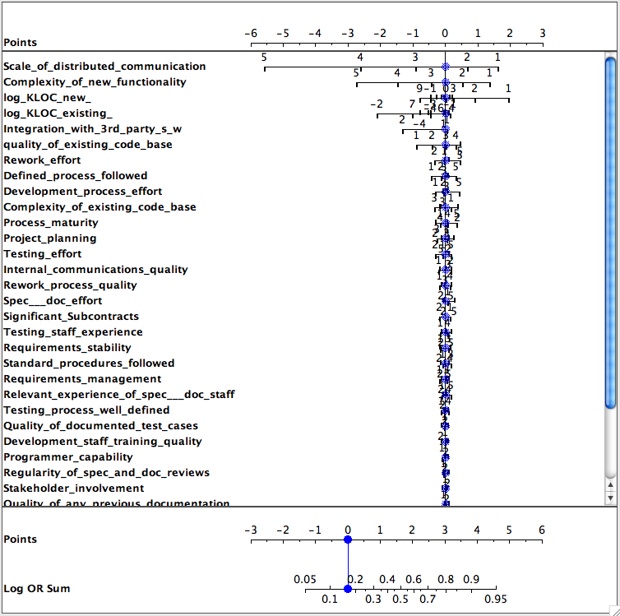
Select features with Nomograms
Nomograms [Mozina04]:
  Discretize every feature.
  For all pairs of target / other classes
  of size C1, C2 count frequency of
  range N1, N2 in each class
  Log(odds ratio) =
  log((N1/C1) / (N2/C2))
  If positive, then more frequent in target
Data from Fenton’s Bayes Nets
  [Fenton08]
  Target class: worst defects
  Useful subset of attributes: 7%
  And of those attributes,
    Only a few ranges matter

Slide 17
Caution
Simple entropy, nomograms,
  running in linear time
  not the best feature selector
Best = WRAPPER
  A search through all subsets of F features
  Warning: may be impractical for large data sets
Mixed strategies
  Send out the scouts (e.g. nomograms) to quickly prune
  Before firing the big guns (WRAPEPR)

Slide 18
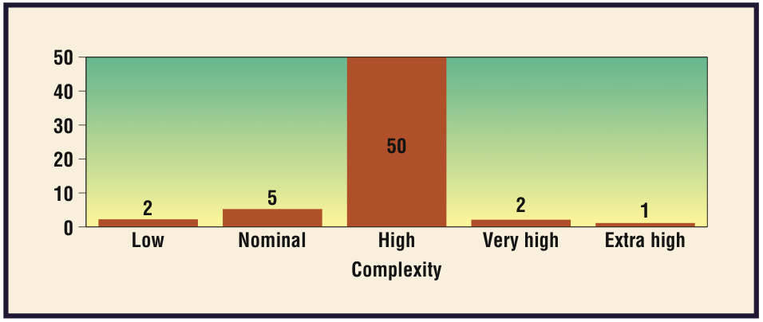
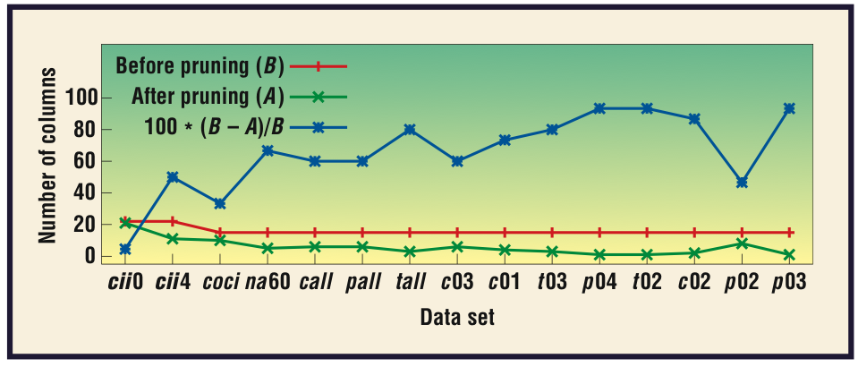
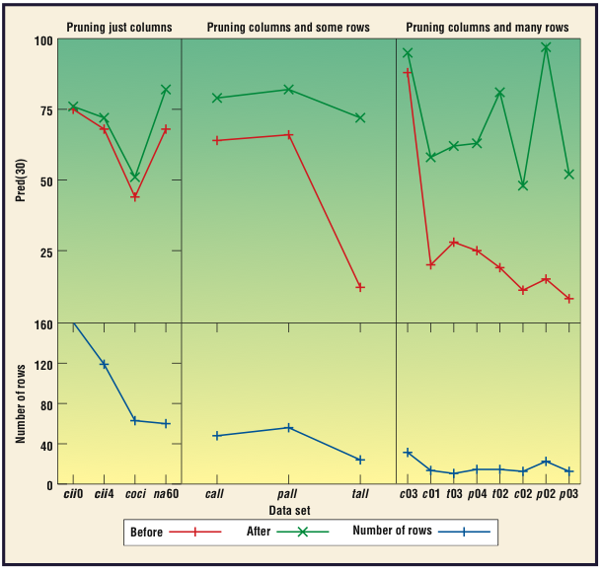
Example 1: Select columns with WRAPPER for effort estimation
  Reference: [Menzies05]
  Useful = 65%

Slide 19
Example 2: Select columns with WRAPPER for defect prediction
  10-way cross-val, LSR, on [Bn08]
  Defects =
  82.2602 * S1=L,M,VH +
  158.6082 * S1=M,VH +
  249.407 * S1=VH +
  41.0281 * S2=L,H +
  68.9153 * S2=H +
  151.9207 * S3=M,H +
  125.4786 * S3=H +
  257.8698 * S4=H,M,VL +
  108.1679 * S4=VL +
  134.9064 * S5=L,M +
  -385.7142 * S6=H,M,VH +
  115.5933 * S6=VH +
  -178.9595 * S7=H,L,M,VL +
  ...
  [ 50 lines deleted ]
WRAPPER:
  Search for attributes that matter, 10 times on 90% of the data
  Only build model from attributes selected at least 50% of the time.
  Defects =
  876.3379 * S7=VL +
  -292.9474 * D3=L,M + 483.6206 * P5=M + 5.5113 * KLoC +
  95.4278
  Uses 4/53 = 8% o f the data
R² = 0.45 (mean on x-val)
R²=0.98 (mean on x-val)

Slide 20

Implications for data quality planning
A warning: it may be a waste of effort to:
  Expend great effort to precisely define all possible data points,
  Then spend much time collecting data according to those definitions.
Rather, more effective to:
  Quickly implement a draft definition/collection plan.
  As soon as any data is available, apply feature selection.
  Only elaborate data that feature selection reports are significant.

Slide 21
Summary

Slide 22
Explaining the surprising conclusions of PROMISE
Value of
conclusions
Given the local conditions of a particular project,
  Only a small number of features are insignificant:
  E.g. 38%, 26%, 14%, 11%, 63%, 7%, 7%
So in a large pool of messy data
  They may exist a subset that is still useful for prediction
So real-world data is good, providing you get enough of it, and throw most of it away before you learn
actual
believed
Collection effort

Slide 23
Open issues in data quality
(for software engineering)
Conclusion Instability
Locality
Best way to find significant data
  How to import data from other sites
  Relevancy filtering
  Feature selection

Slide 24
References
[Basili02] Victor Basili, Roseanne Tesoriero, Patricia Costa, Mikael Lindvall, Ioana Rus, Forrest Shull, and Marvin Zelkowitz. Building an experience base for software engineering: A report on the first cebase eworkshop. In in Profes (Product Focused Software Process Improvement, pages 110–125, 2001.
  [Bn08] http://iccle.googlecode.com/svn/trunk/share/data/arff/bn.arff
  [Brady10] Adam Brady and Tim Menzies. Case-Based Reasoning vs. Parametric Models for Software Quality Optimization, PROMISE’10
  [Fenton08] Project Data Incorporating Qualitative Factors for Improved Software Defect Prediction Norman Fenton, Martin Neil, William Marsh, Peter Hearty, Lukasz Radlinski and Paul Krause., PROMISE 2008
[Gentleman07] R. Gentleman and D. Temple Lang. Statistical analyses andreproducible research. Journal of Computational andGraphical Statistics, 16(1):1–23, March 2007.
[Leisch02] F. Leisch. Sweave: Dynamic generation of statistical reportsusing literate data analysis. In W. Härdle and B. Rönz, editors,Proceedings in Computational Statistics (2002), pages575–580. Physica 2002.
  [Menzies05] Tim Menzies with Scott Chen and Dan Por and Barry Boehm, Finding the Right Data for Software Cost Modeling , IEEE Software Nov/Dec 2005
  [Menzies06] T. Menies, K. Lum, and J. Hihn. The deviance problem in effort estimation. In PROMISE, 2006,
[Menzies07] T. Menzies with G. Boetticher, and T. Ostrand. PROMISE Repository of empirical software engineering data. WestVirginia University, Department of Computer Science, 2007.http://promisedata.org/.
[Menzies10] Ekrem Kocaguneli, Gregory Gay, Tim Menzies, Ye Yang, Jacky W. Keung: When to use data from other projects for effort estimation. ASE 2010: 321-324
[Menzies10a] Tim Menzies, Zach Milton Burak Turhan,Bojan Cukic et al.Defect prediction from static code features: current results, limitations, new approaches Automated Software Engineering, Dec 2010
[Mozina04] Martin Mozina,, Janez Demsar, Michael Kattan, and Blaz Zupan, Nomograms for Visualization of Naive Bayesian Classifier
[Ostrand10] Programmer-based Fault Prediction Thomas J. Ostrand, Elaine J. Weyuker, Rober t M. Bell. PROMISE’10
[Tosun10] Tosun, A., Bener, A.: AI-based software defect predictors: Applications and benefits. In: IAAI’10 (2010)
[Turhan09] Turhan, B., Menzies, T., Bener, A., Distefano, J.: On the relative value of cross-company and within- company data for defect prediction. Empir. Softw. Eng. 68(2), 278–290 (2009). Available from http://menzies.us/pdf/08ccwc.pdf

Slide 25

Questions?
Comments?

