Slide 1

Empirical Software Engineering, Version 2.0
Tim Menzies, WVU, USA
Forrest Shull, Fraunhofer , USA
(with John Hoskings, UoA, NZ)
Jan 27-2011

Slide 2


About us
Curators of large repositories of SE data
  Searched for conclusions
Shull: NSF-funded CeBase 2001- 2005
  No longer on-line
Menzies: PROMISE 2006-2011
  If you publish, offer data used in that pub
  http://promisedata.org/data
Our question:
  What’s next?

Slide 3
Summary
We need to do more “data mining”
  Not just on different projects
  But again and again on the same project
And by “data Mining” we really mean
  Automated agents that implement
    prediction
    monitoring
    diagnosis,
    Planning
    Adaptive business intelligence

Slide 4
Adaptive Business Intelligence
learning, and re-learning,
How to….
  Detect death march project
  Repair death march projects
  Find best sell/buy point for software artifacts
  Invest more (or less) in staff training/dev programs
  Prioritize software inspections
  Estimate development cost
  Change development costs
  etc

Slide 5
This talk
A plea for industrial partners to join in
A roadmap for my next decade of research
  Many long term questions
  A handful of new results

Slide 6
Data Mining & Software Engineering

Slide 7
So many applications of data mining to SE
Process data
  Input: Developer skills, platform stability
  Output: effort estimation
Social data
  Input: e.g. which tester do you most respect?
  Output: predictions of what bugs gets fixed first
Product data
  Input: static code descriptions
  Output: defect predictors
Trace data
  Input: what calls what?
  Output: call sequences that lead to a core dump
Usage data
  Input: what is everyone using?
  Output: recommendations on where to browse next
Any textual form
  Input: text of any artifact
  Output: e.g. fault localization

Slide 8
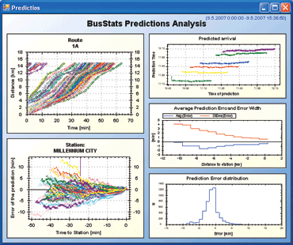


The State of the Art
If data collected, then usually forgotten
Dashboards : visualizations for feature
extraction; intelligence left the user
MapReduce, Hadoop et. al : systems
support for massive, parallel execution.
  http://hadoop.apache.org
  Implements the bus, but no bus drivers
Many SE data mining publications
  e.g. Bird, Nagappan, Zimmermann
  and last slide
  But, no agents that recognize when
  old models are no longer relevant,
  Or to repair old models using new data

Slide 9
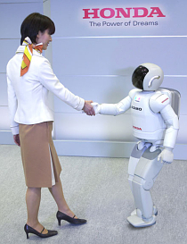
Of course, DM gets it wrong, sometimes
Heh, nobody’s perfect
E.g. look at all the mistakes people make:
  Wikipidea: list of cognitive biases
  38 decision
  making biases
  30 biases in probability
  18 social biases
  10 memory biases
At least with DM, can repeat the analysis, audit the conclusion.
Create agent communities, each with novel insights and limitations
  Data miners working with humans
  See more together than separately
  Partnership

Slide 10
Does this change empirical SE research?

Slide 11
Ben Shneiderman, Mar’08
The growth of the World Wide Web ... continues to reorder whole disciplines and industries. ...
It is time for researchers in science to take network collaboration to the next phase and reap the potential intellectual and societal payoffs.
  -B. Shneiderman.
  Science 2.0.
  Science, 319(7):1349–1350, March 2008

Slide 12
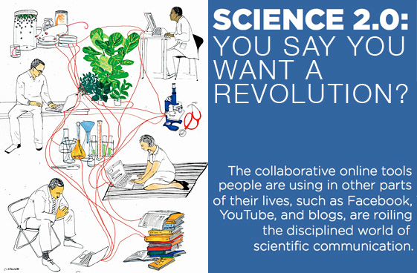
Science 2.0

Slide 13
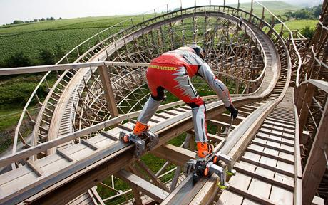
A proposal
Add roller skates to software engineering
Always use DM (data mining) on SE data

Slide 14
What’s the difference?
SE research v1.0
SE research v2.0
Case studies
  Watch, don’t touch
Experiments
  Vary a few conditions in a project
Simple analysis
  A little ANOVA, regression, maybe a t-test
Data generators
  Case studies
  Experiments
Data analysis
  10,000 of possible
  data miners
Crowd-sourcing
  10,000 of possible analysts

Slide 15

Value-added (to case-study-based research)
Case studies: powerful for defining problems, highlighting open issues
Has documented 100s of candidate methods for improving SE development
e.g. Kitchenham et. Al IEEE TSE, 2007,
  Cross versus Within-Company Cost Estimation
  Spawned a sub-culture of researchers
    checking if what works here also works there.

Slide 16

Case-Study-based Research:
Has Limits
Too slow
  Years to produce conclusions
  Meanwhile, technology base changes
Too many candidate methods
  No guidance on what methods to apply to particular projects
Little generality
  Zimmermann et. al, FSE 2009
    662 times : learn here, test there
    Worked in 4% of pairs
  Many similar no-generality results
    Chpt1, Menzies & Shull

Slide 17
Case-studies + DM =
Better Research
Propose a partnership between
  case study research
  And data mining
Data mining is stupid
  Syntactic, no business knowledge
Case studies are too slow
  And to check for generality? Even slower
Case study research (on one project) to raise questions
  Data mining (on many projects) to check the answers

Slide 18
Adaptive Agents

Slide 19
Need for adaptive agents
No general rules in SE
  Zimmermann FSE, 2009
But general methods to find the local rules
Issues:
  How quickly can we learn the local models?
  How to check when local models start failing?
  How to repair local models?
An adaptive agent watching a stream of data, learning and relearning as appropriate

Slide 20
Agents for adaptive business intelligence
Quality
(e.g.
PRED(30))
mode #2
mode #1
learn
mode #3
learn
break
down
break
down
learn
Data collected over time

Slide 21
Agents for adaptive business intelligence
Quality
(e.g.
PRED(30))
mode #2
mode #1
learn
mode #3
learn
break
down
break
down
learn
Data collected over time
What is different here?
  Not “apply data mining to build a predictor”
  But add monitor and repair tools to recognize and handle the breakdown of old predictors
  Trust = data mining + monitor + repair

Slide 22
If crowd sourcing
Quality
(e.g.
PRED(30))
mode #2
mode #1
Company#1
mode #3
Quality
(e.g.
PRED(30))
mode #5
Company #2
mode #4
mode #6
Quality
(e.g.
PRED(30))
mode #8
mode #7
Company #3
mode #9
With DM, we could recognize that e.g. 1=4=7
i.e. when some “new” situation has happened before
So we’d know what experience base to exploit

Slide 23
Research Questions.
How to handle….
Anonymization
  Make data public, without revealing private data
Volume of data
  Especially if working from “raw” project artifacts
  Especially if crowd sourcing
Explanation : of complex patterns
Noise: from dad data collection
Mode recognition
  Is when new is stuff is new, or a a repeat of old stuff
Trust : you did not collect the data
  Must surround the learners with assessment agents
    Anomaly detectors
    Repair

Slide 24
Most of the technology required for this approach can be implemented via data mining

Slide 25
So it would scale to large data sets

Slide 26
Organizing the artifacts

Slide 27
Visual Wiki (“Viki”) concept

Slide 28
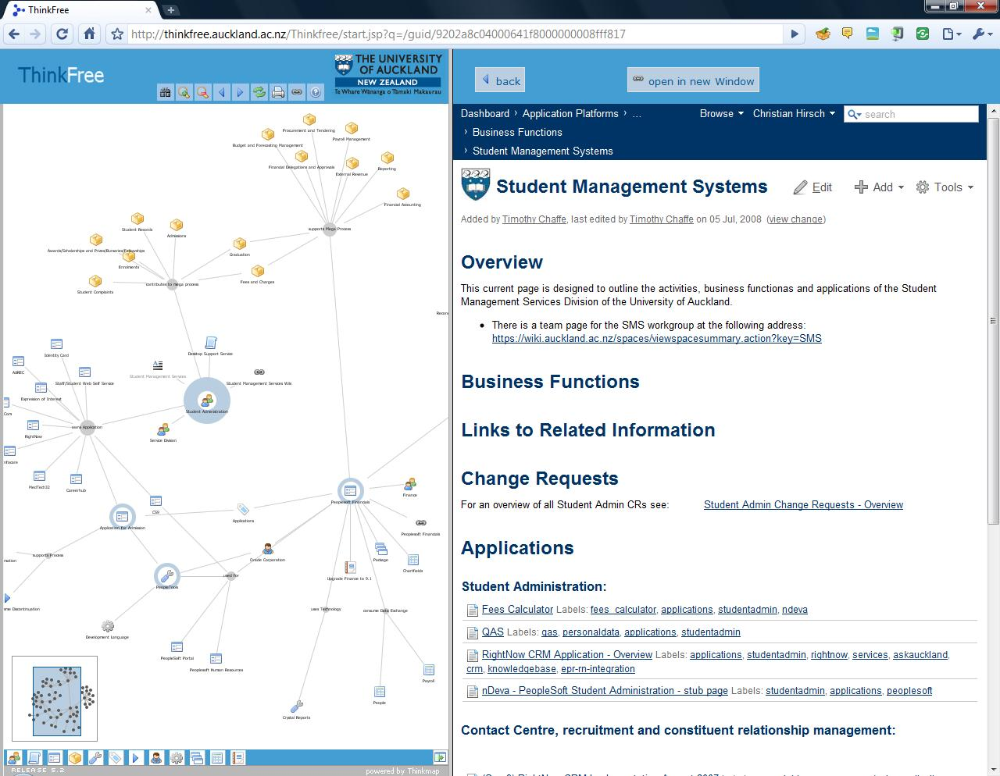
Enterprise Artifacts example
Add documents; organize; search; navigate
Edit properties, documents, add links, extract links

Slide 29
Various Vikis
Bottom left: business process descriptions

Slide 30
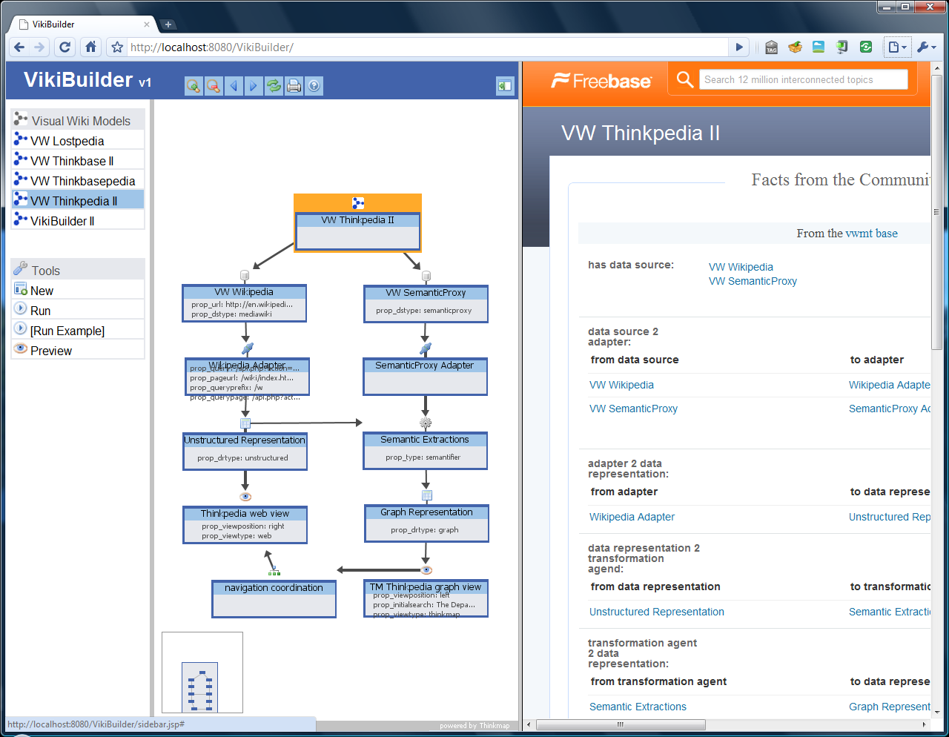
VikiBuilder – generating Vikis

Slide 31
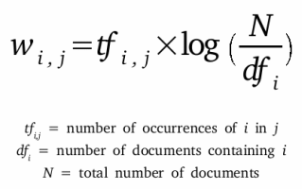
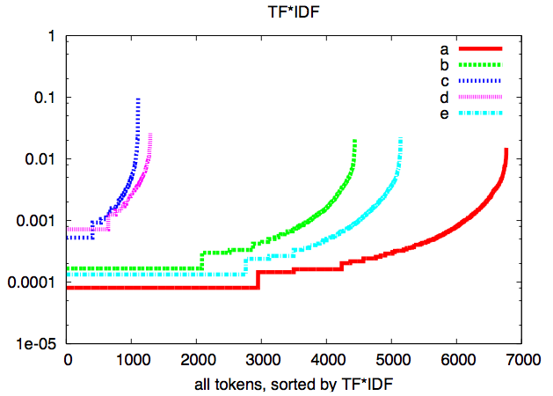
Text mining
Key issue: dimensionality reduction
In some domains, can be done in linear time
Use standard data miners, applied to top 100 terms in each corpus

Slide 32
Details

Slide 33
Agents for adaptive business intelligence
Quality
(e.g.
PRED(30))
mode #2
mode #1
learn
mode #3
learn
break
down
break
down
learn
Data collected over time
Q1: How to learn faster?
  Technology: active learning: reflect on examples to date to ask most informative next question
Q2: How to recognize breakdown?
  Technology: bayesian anomaly detection
  Focusing on frequency counts of contrast sets

Slide 34
Agents for adaptive business intelligence
Quality
(e.g.
PRED(30))
mode #2
mode #1
learn
mode #3
learn
break
down
break
down
learn
Data collected over time
Q3: How to classify a mode?
  Recognize if you’ve arrived at a mode seen before
  Technology: Bayes classifier
Q4: How to make predictions?
  Using the norms of a mode, report expected behavior
  Technology: table look-up of data inside Bayes classifier

Slide 35
Agents for adaptive business intelligence
Quality
(e.g.
PRED(30))
mode #2
mode #1
learn
mode #3
learn
break
down
break
down
learn
Data collected over time
Q5: What went wrong? (diagnosis)
  Delta between current and prior, better, mode
Q6: What to do? (planning)
  Delta between current and other, better, mode
Technology: contrast set learning

Slide 36
Agents for adaptive business intelligence
Quality
(e.g.
PRED(30))
mode #2
mode #1
learn
mode #3
learn
break
down
break
down
learn
Data collected over time
Q7: How to understand a mode (explanation)
  Presentation of essential features of a mode
Technology: contrast set learning

Slide 37
Prototypes
Bits and pieces

Slide 38
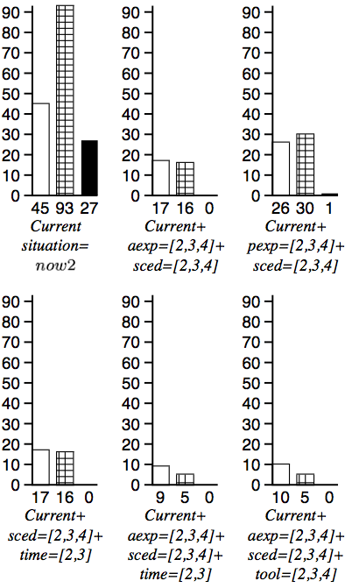
Contrast set learning
Minimal contrast set learning = diagnosis &planning
A decision tree with weighted leaves
  Treatment = decisions that prune branches
    Culls bad weights
    Keeps good weights
E.g. Simulator + C4.5 + 10-way
  10 * 1000 node trees
  TAR1: tiny rules: decision on 4 ranges
Why so small?
  Higher decisions prune more branches
    touch fewer nodes

Slide 39
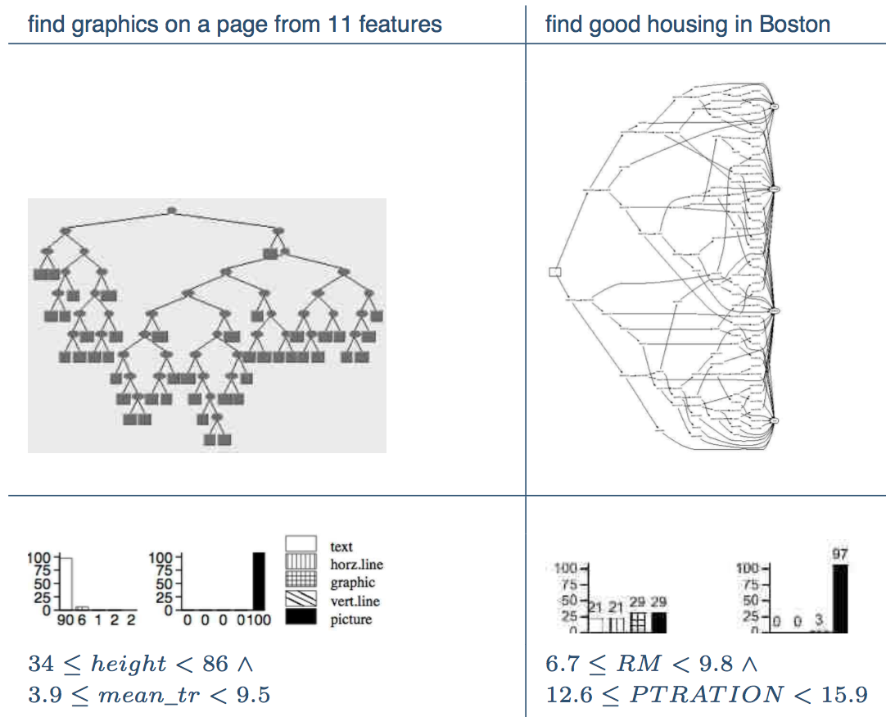
Contrast Set Learning ➔
Succinct Explanations

Slide 40
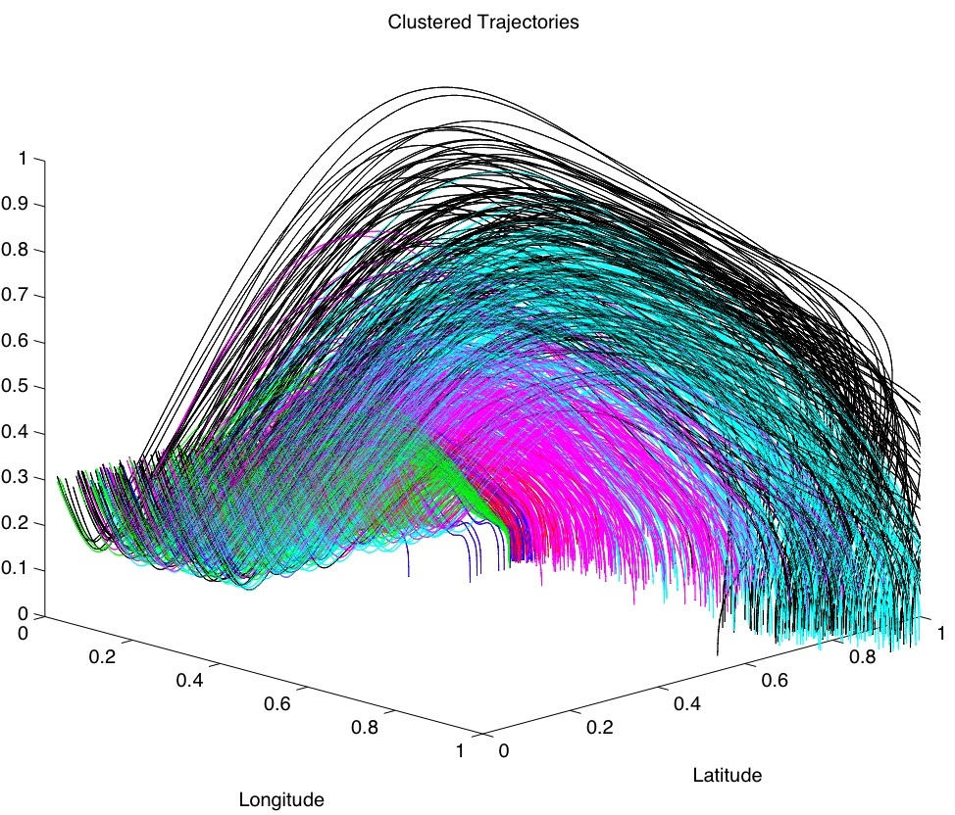
Contrast Set Learning
(10 years later)
No longer a post-processor to a decision tree learner
  TAR3: Branch pruning operators applied directly to discretized data
Summer’09
  Shoot ‘em up at NASA AMES
  State-of-the-art numerical optimizer
  TAR3
    Ran 40 times faster
    Generated better solutions
Powerful succinct explanation tool

Slide 41
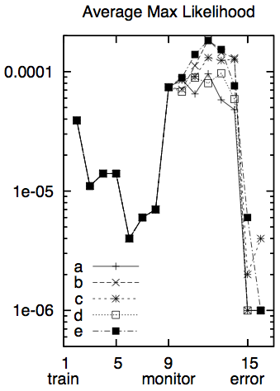
Contrast Set Learning ➔ Anomaly Detection
Recognize when old ideas
are now out-dated
SAWTOOTH:
  read data in “eras” of 100 instances
  Classify all examples as “seen it”
SAWTOOTH1:
  Report average likelihood of examples belong to “seen it”
  Alert if that likelihood drops
SAWTOOTH2:
  Back-end to TAR3
  Track frequency of contrast sets
  Some uniformity between contrast sets and anomaly detection

Slide 42
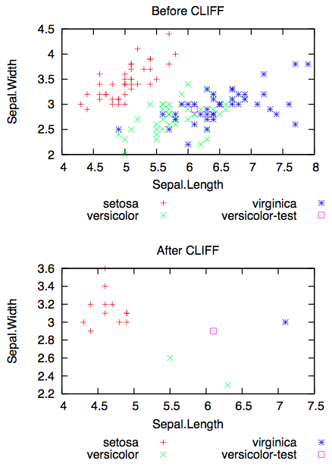
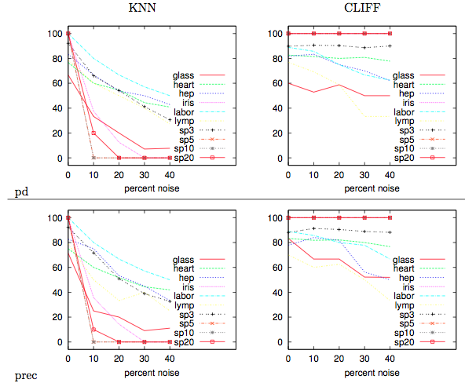
Contrast sets ➔ noise management
CLIFF: post-processor to TAR3
  Linear time instance selector
Finds the attribute ranges that change classification
Delete all instances that lack the “power ranges”

Slide 43
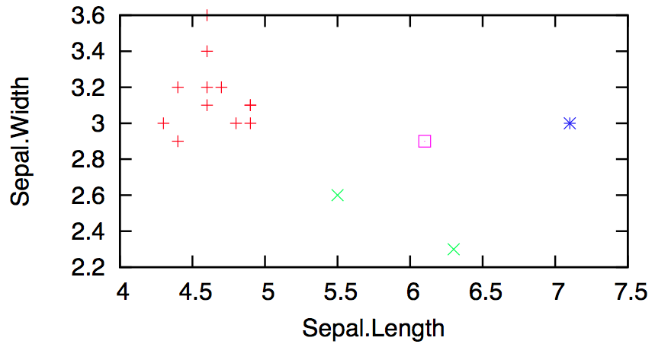
Contrast Sets ➔ CLIFF ➔
Active Learning
Many examples, too few labels
Reduce the time required for business users to offer judgment on business cases
Explore the reduced space generated by CLIFF.
    Randomly ample the instances half-way between different classes
Fast (in the reduced space)

Slide 44
Contrast sets ➔ CLIFF ➔ Statistical databases
Anonymize the data: Preserving its distributions
For KNN, that means keep the boundaries between classes
  Which we get from CLIFF
Also, CLIFF empties out the instance space
  Leaving us space to synthesize new instances

Slide 45
And so…

Slide 46
We seek industrial partners
That will place textual versions of their products in a wiki
That will offer joins of those products to quality measures
That will suffer us interviewing their managers, from time to time, to learn the control points.
(Note: 1,2 can be behind your firewalls.)

Slide 47
In return, we offer
Agents for
  automatic, adaptive, business intelligence
  that tunes itself to your local domain

Slide 48
Questions?
Comments?

