Slide 1
AI & Gaming
Letters from the Land of Lisp
tim@menzies.us
http://tinyurl.com/ai-and-games

Slide 2
Exciting times (1)
Masters-level gaming certificate approved (finally)

Slide 3
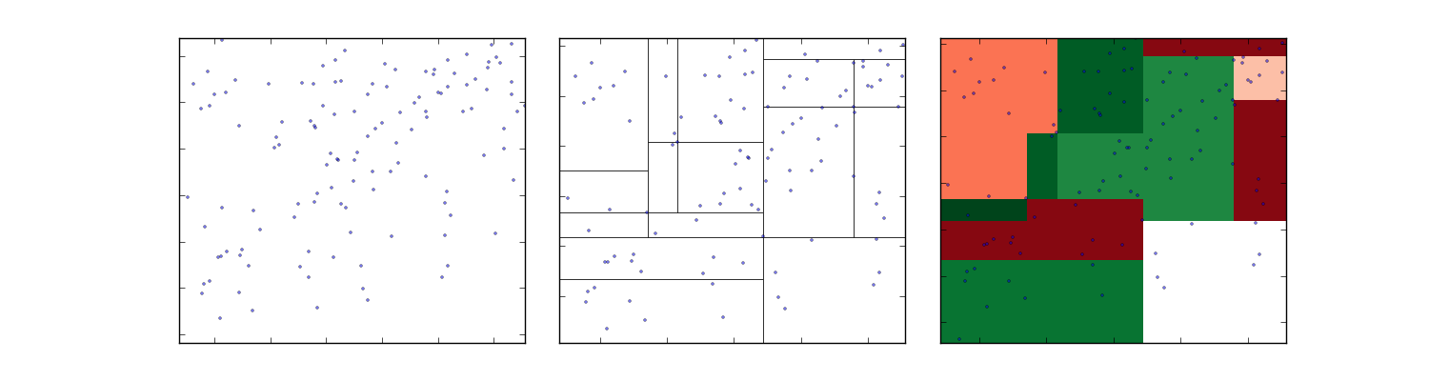
Exciting times (2)
Recent advances in complex visualizations
The manager game

Slide 4

Challenge
Teaching Dora
  20 second attention span
  These are my students
Teaching hard (AI) stuff
  Lazy evaluation of
  infinite trees
  Higher-order functional programming
  Genetic algorithms
  Graph theory
  Etc
http://tinyurl.com/ai-and-games

Slide 5
Solution: Teach via Gaming
Keeps Dora’s attention
Responsible
  Gaming is a massive growth industry
  Gaming = jobs
http://tinyurl.com/ai-and-games

Slide 6
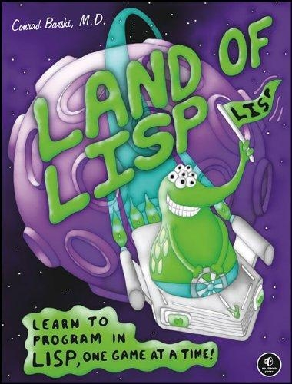
Teach games, in LISP
Land of LISP
  Conard Baraksi
“Turns out the border between genius and insanity is a pretty cheery place”
  Paul Graham
http://tinyurl.com/ai-and-games

Slide 7
Why LISP?
My predictor for success at graduate studies
  If you can handle LISP…
Core view of computation
It’s the source
  LISP ➔ Scheme ➔ functional languages
  Scheme ➔ Io, Lua, etc, etc
Innovations first prototypes in LISP
  AI algorithms
  Real-time operating systems
  Garbage collection
  Object-oriented programming
  Logic programming
http://tinyurl.com/ai-and-games

Slide 8
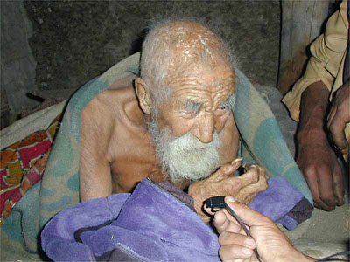
Who cares?
Old Man’s language!
http://tinyurl.com/ai-and-games

Slide 9
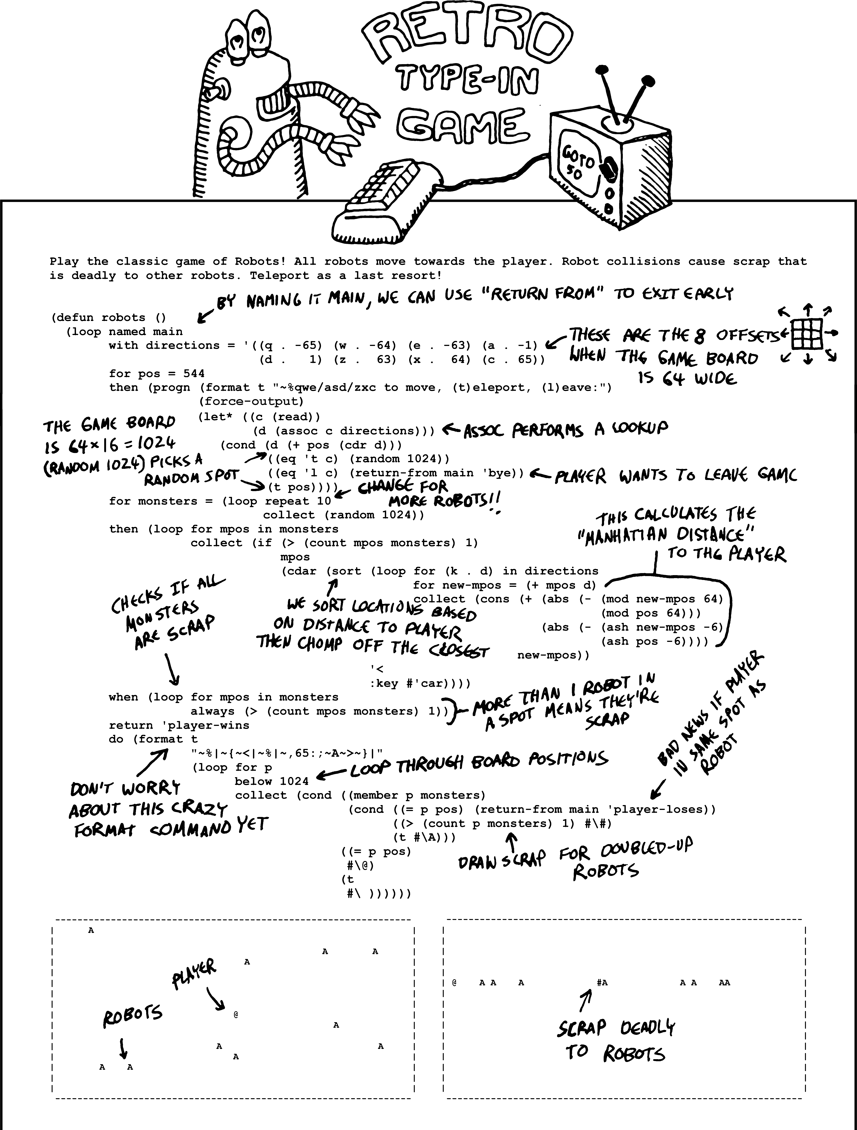
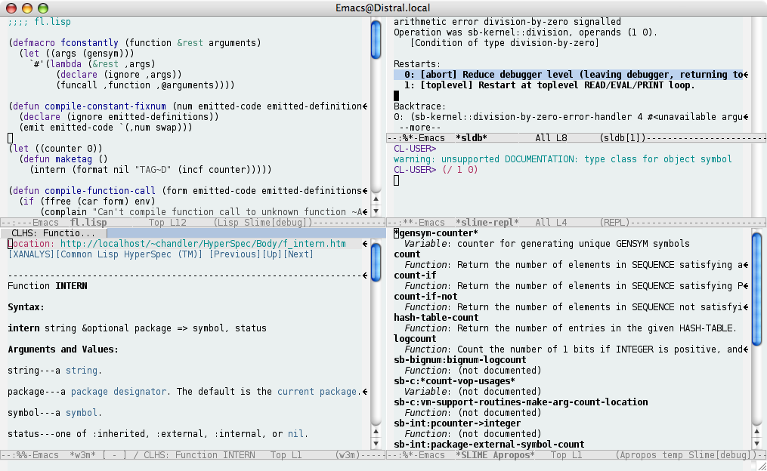
LOL: LISP is cool, again
http://tinyurl.com/ai-and-games

Slide 10
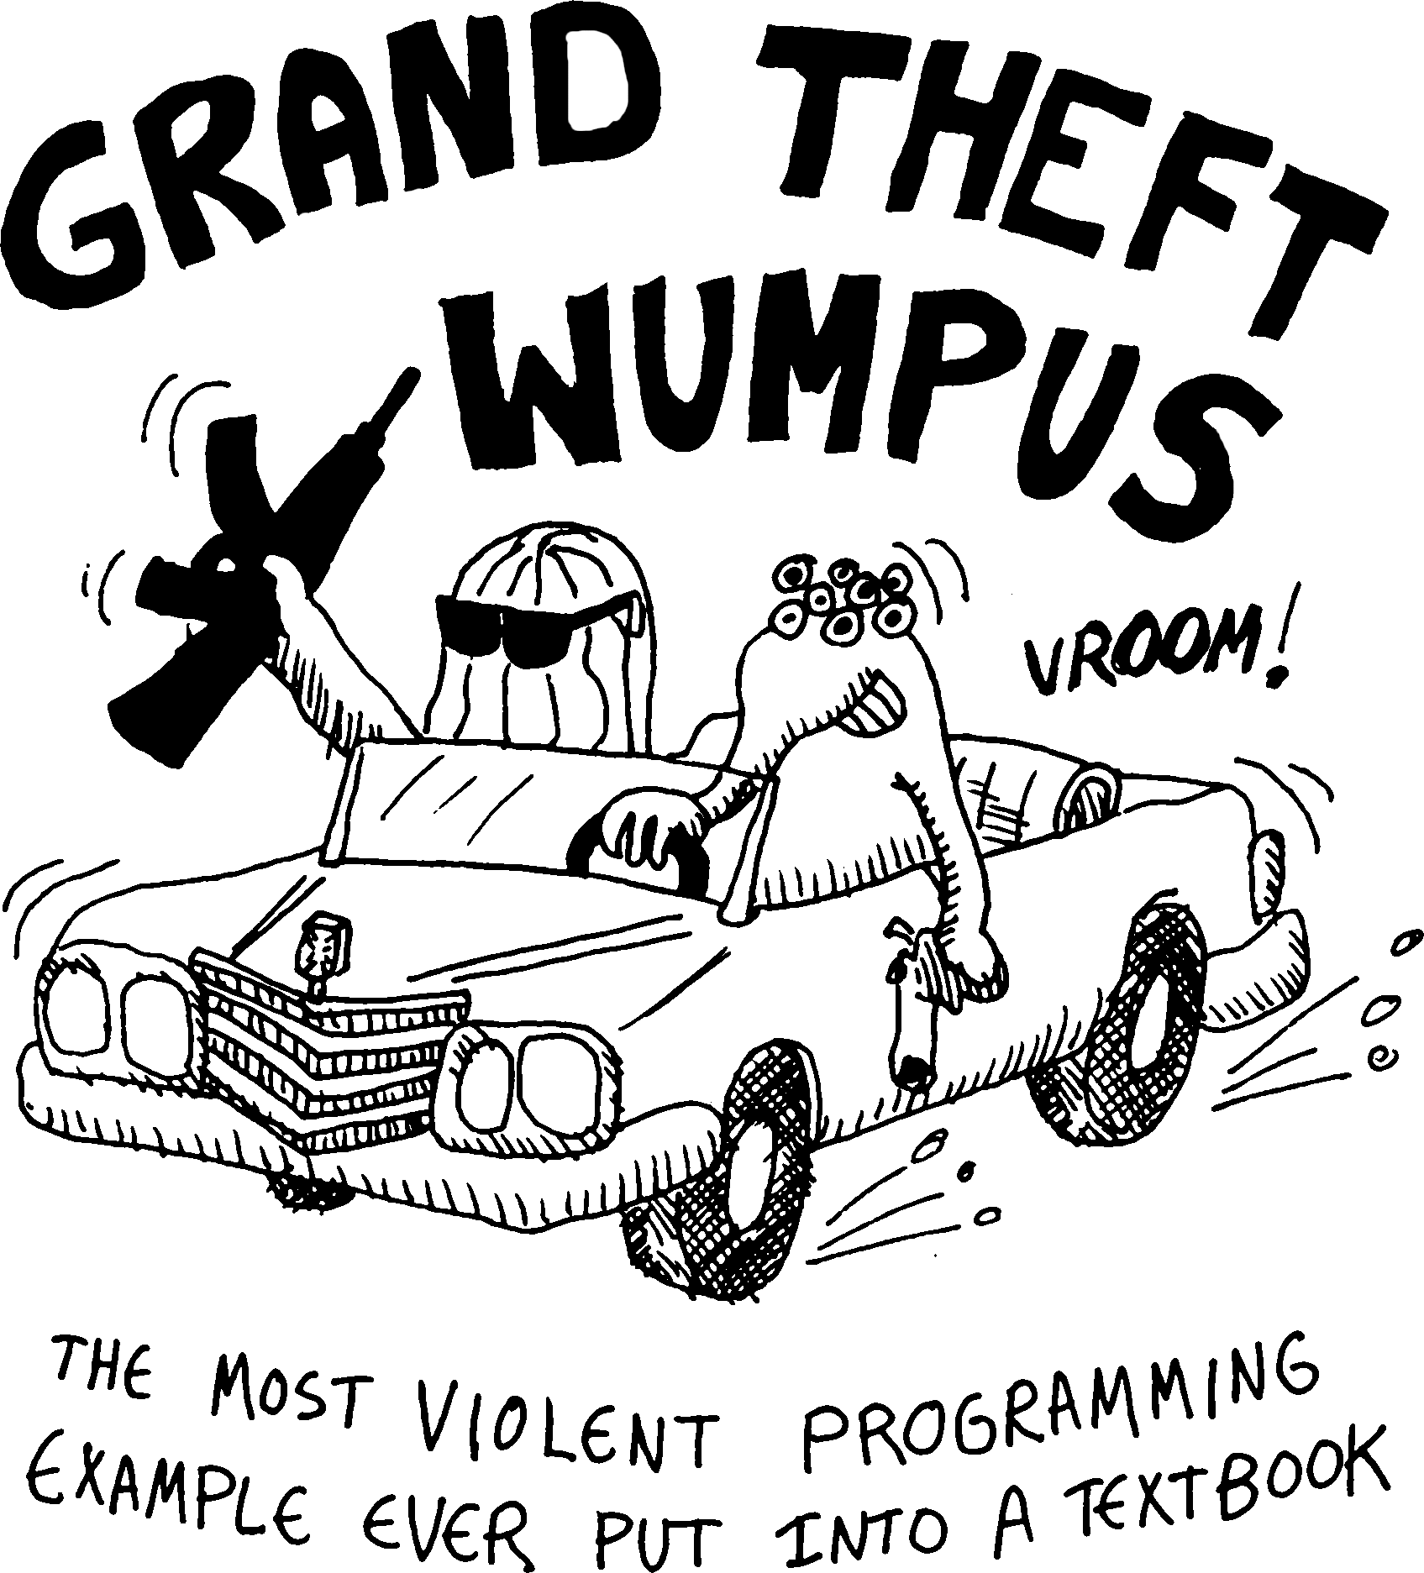
Smiles for all the girls and boys
http://tinyurl.com/ai-and-games

Slide 11

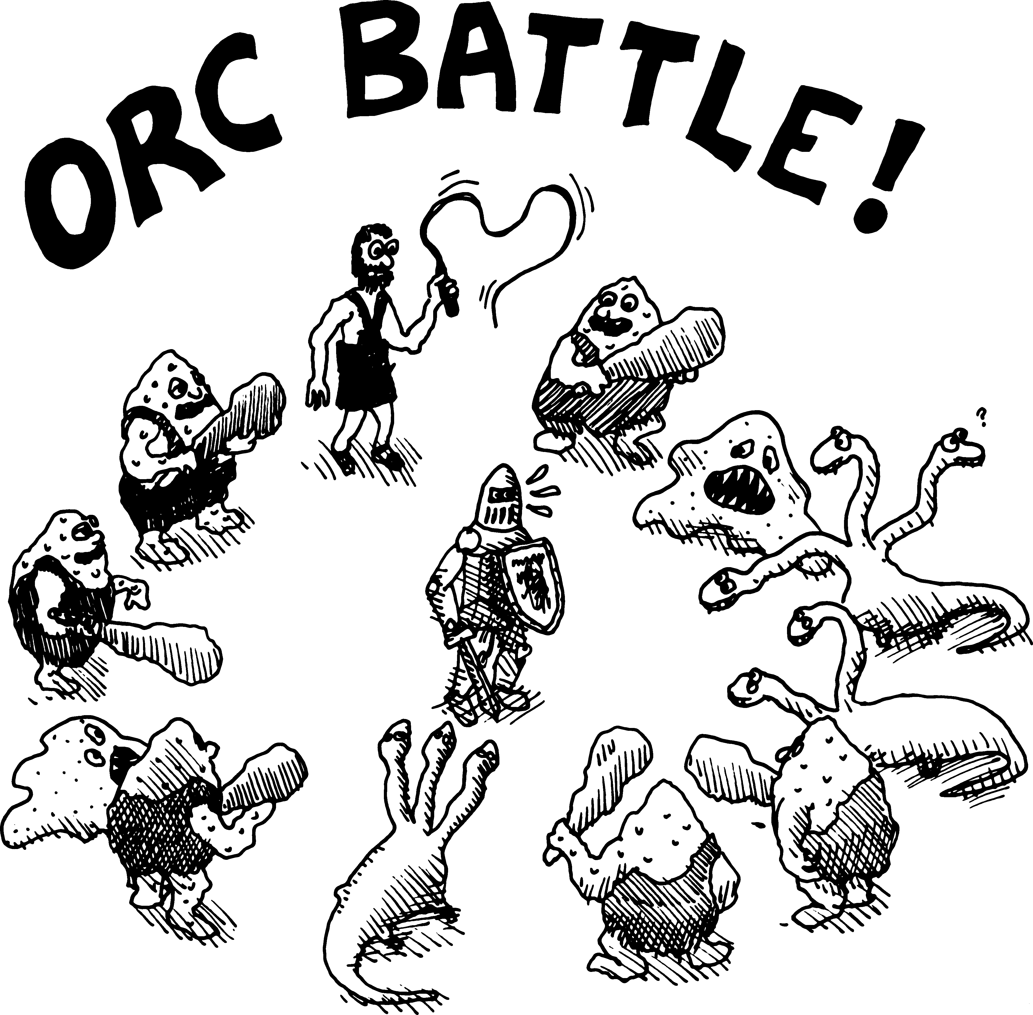
Gore!
Not bore!
http://tinyurl.com/ai-and-games

Slide 12
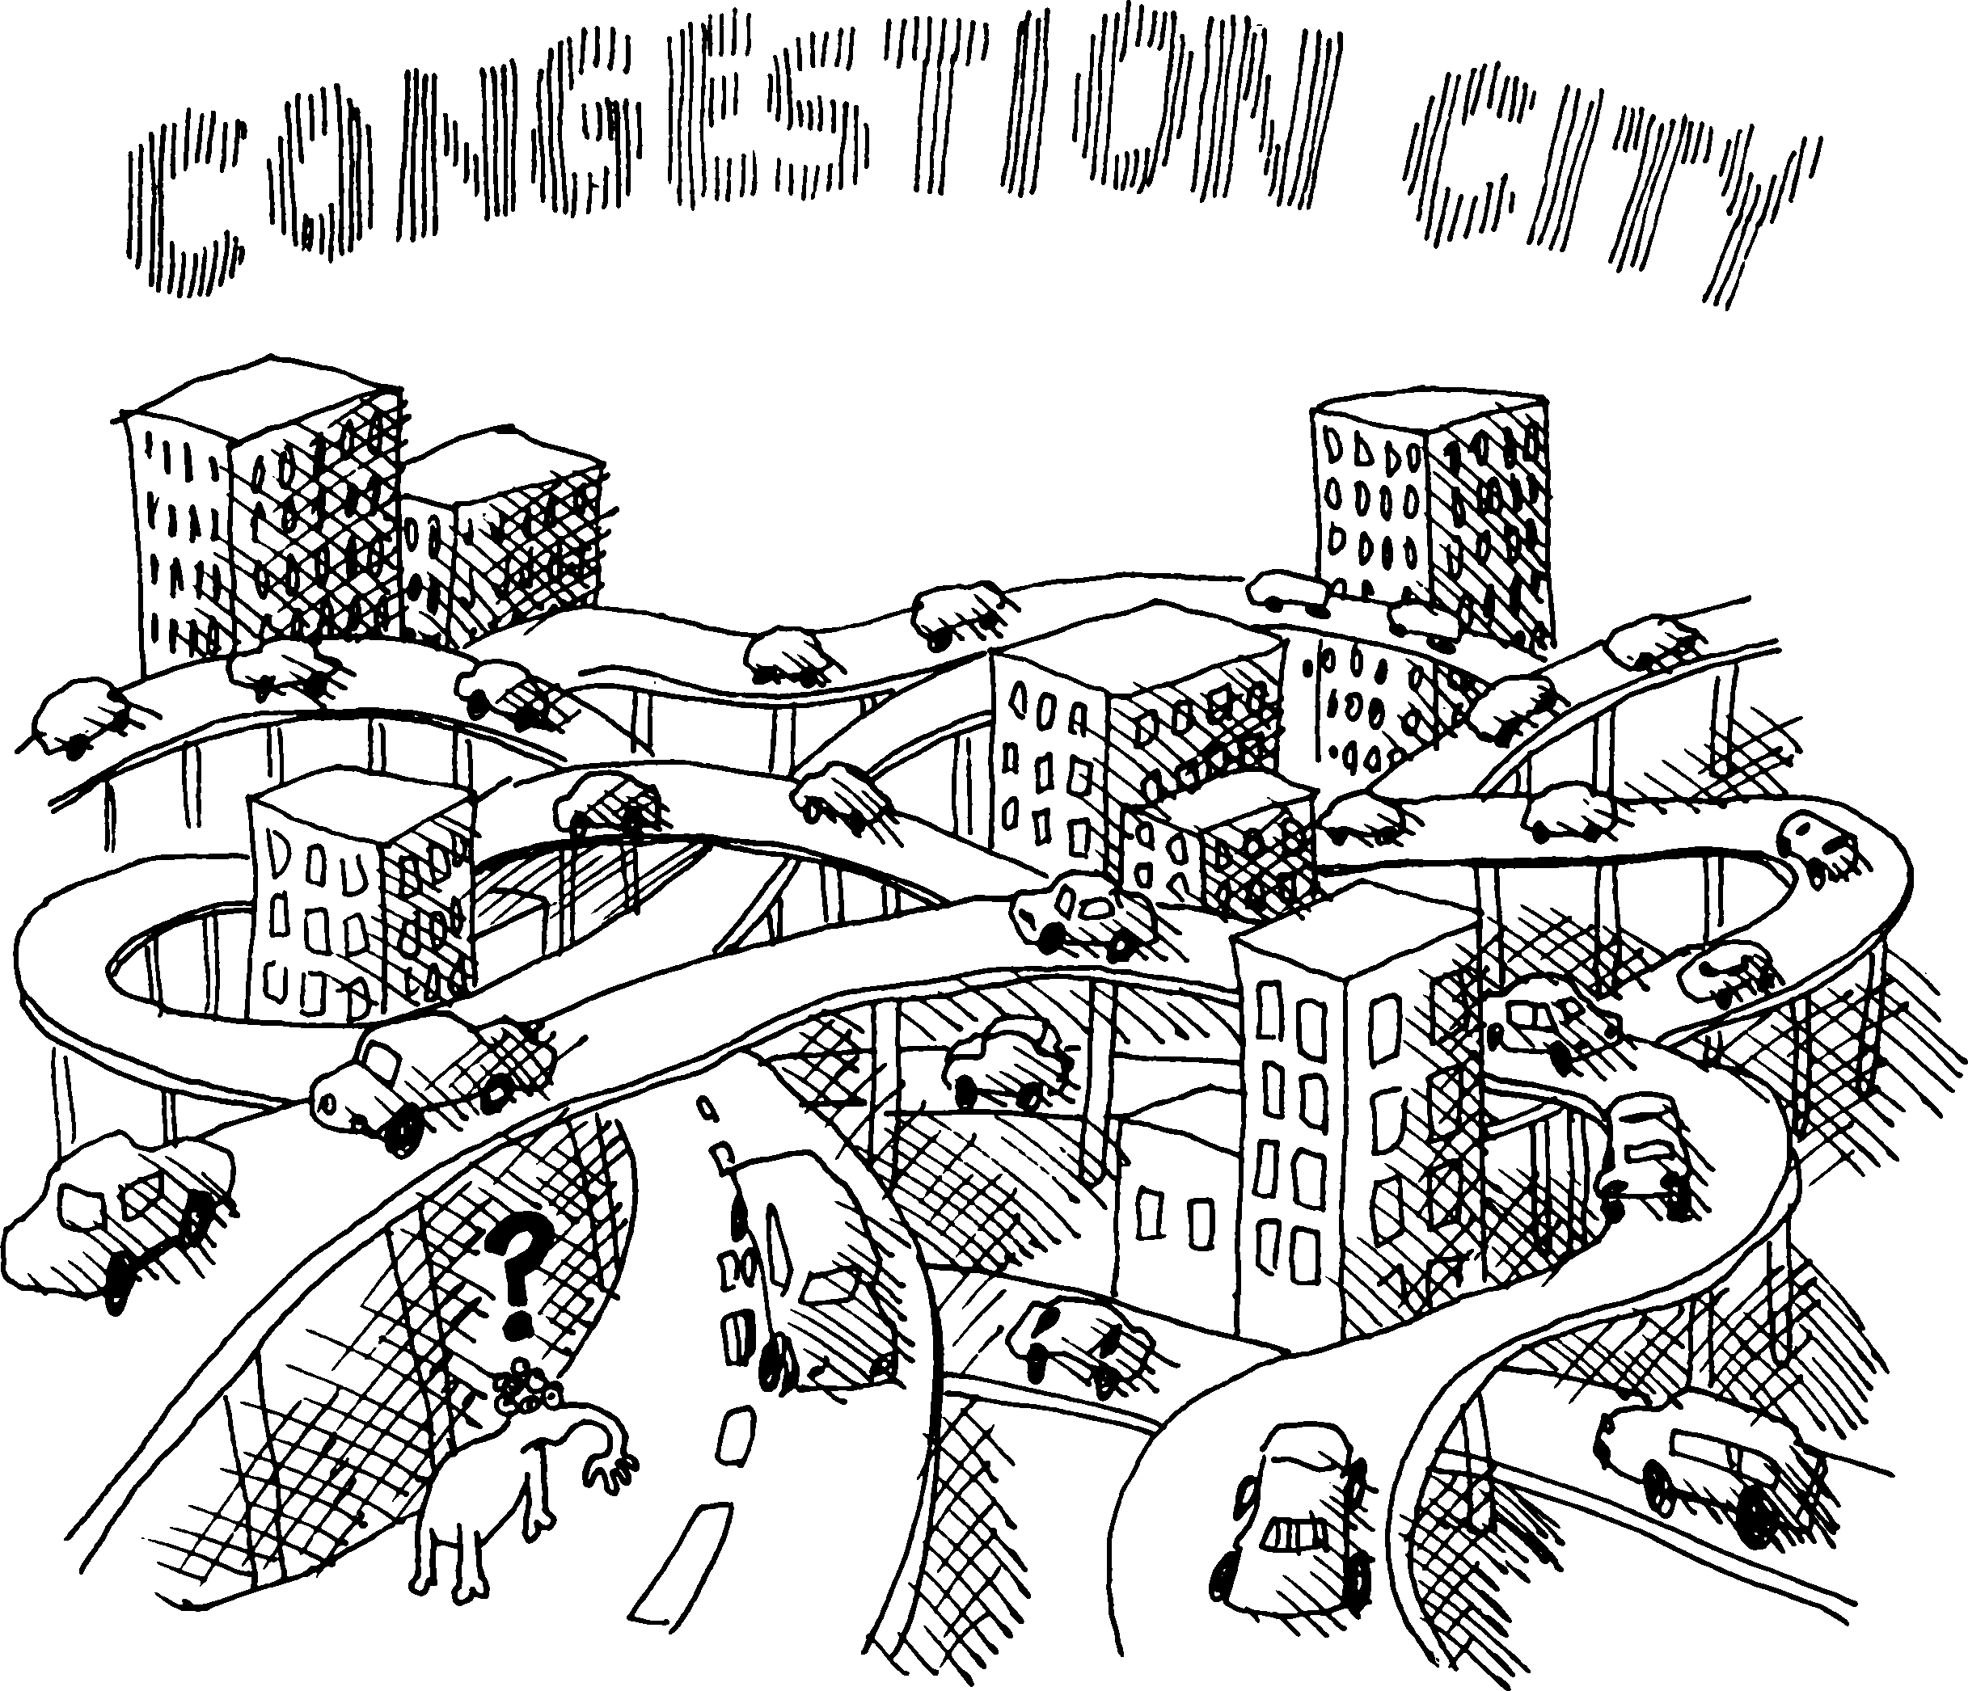
Sneaks in Graph Theory
http://tinyurl.com/ai-and-games

Slide 13
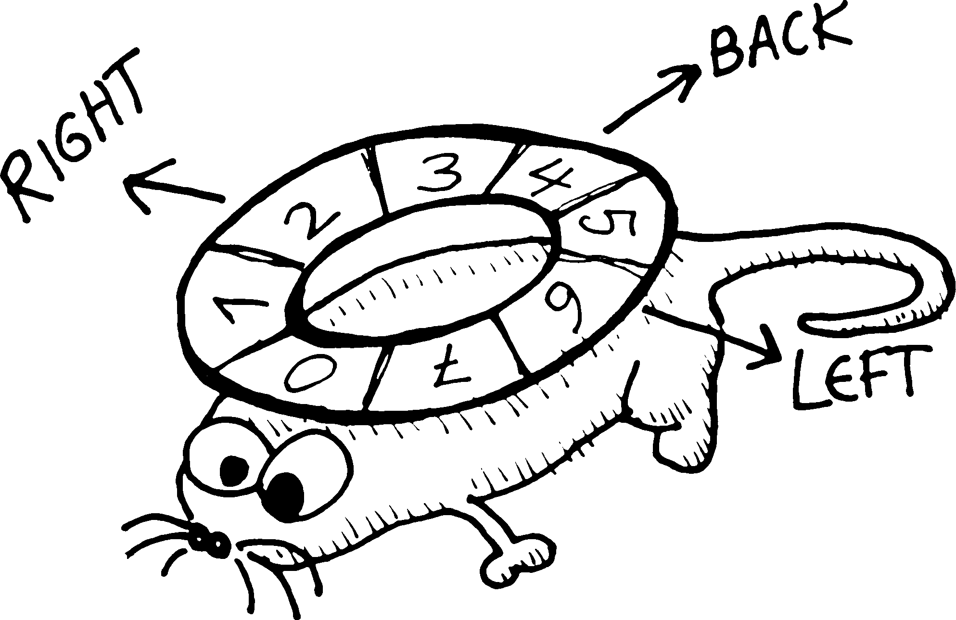
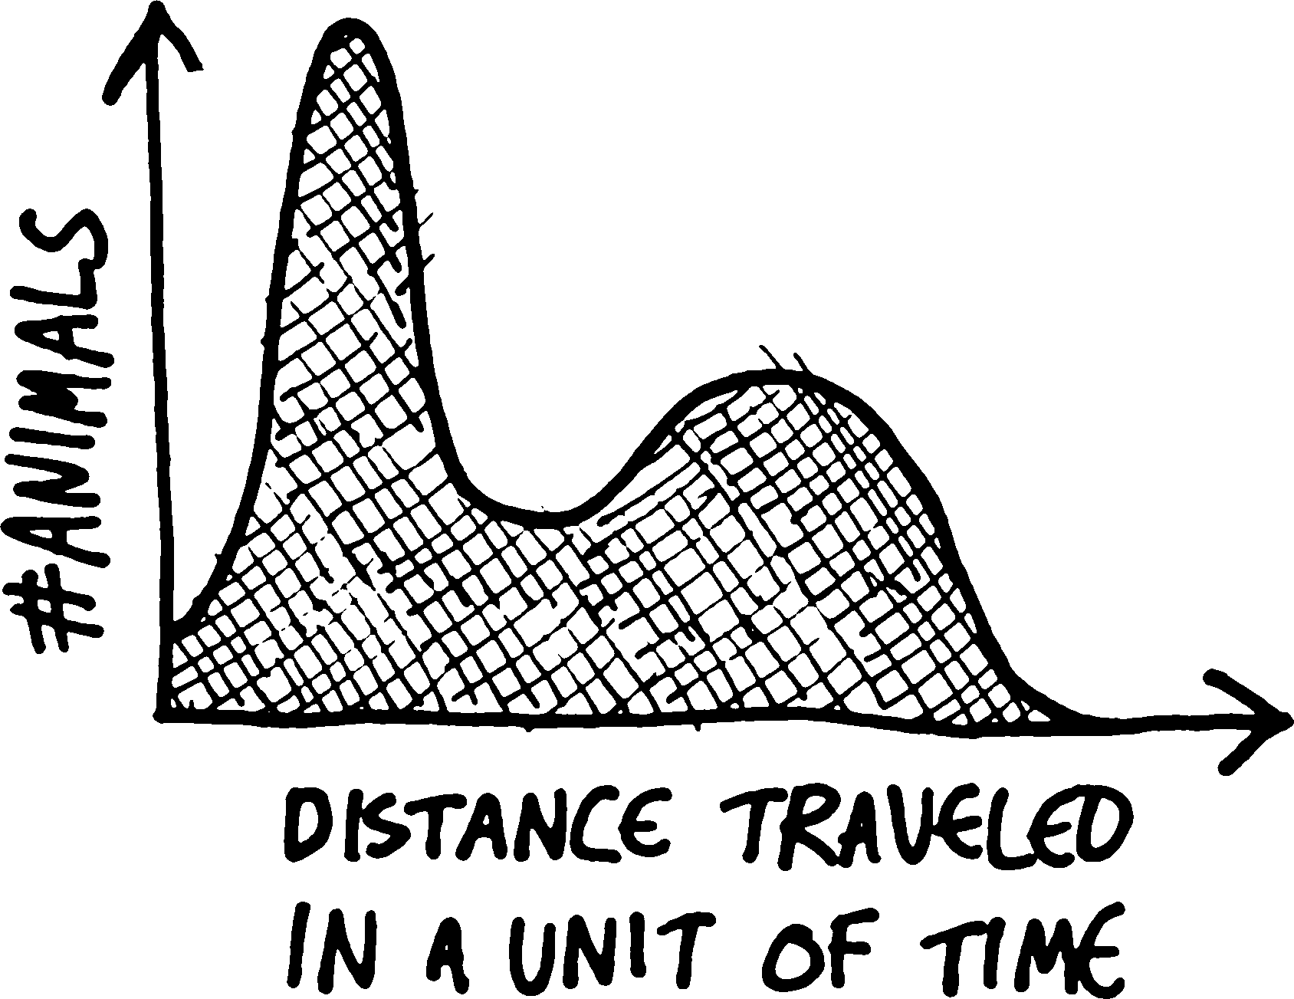
Genetic algorithms
Tiny desert world: one oasis
Populated by rats, learning
which way to run
5,000,000 years later, two species
  Both get enough to eat
  One runs very fast,
    stumbling back to the oasis
  One sits still in the oasis
http://tinyurl.com/ai-and-games

Slide 14
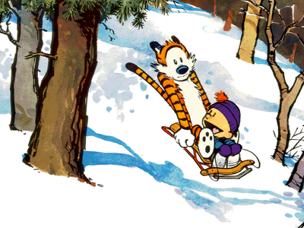
Careful, we might learn something
Statistics
Graph theory
Emergent behaviors
Genetic programming
Functional programming
Running large experiments
Evolutionary algorithms
http://tinyurl.com/ai-and-games

Slide 15
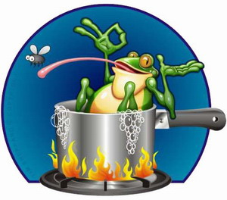
Boiling frogs
LOL: pace so gentle, tasks so fun
  Students don’t realize how deep they are going
By the end of the book
  Web-server,
  Alpha-beta prune
  Interactive graphics
  Web server
  Higher-order functions
  Computation over
  infinite structures
    Using continuations
  Etc
http://tinyurl.com/ai-and-games

Slide 16
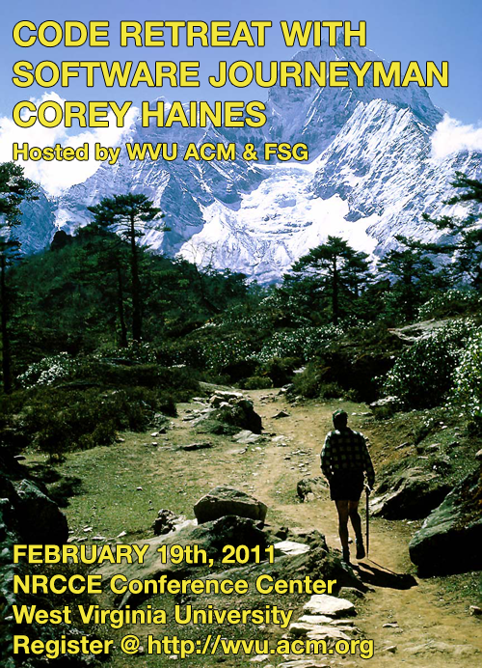
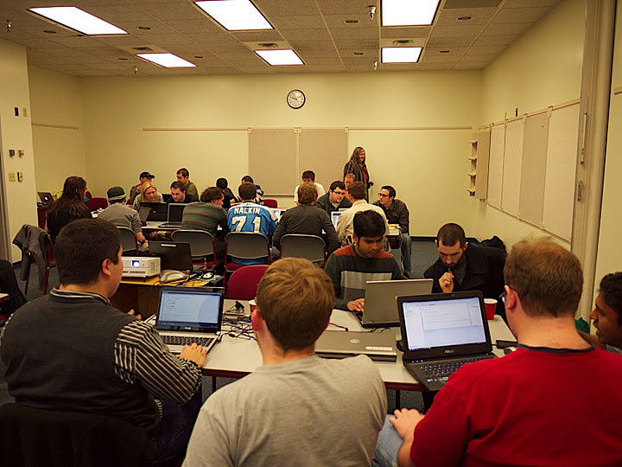
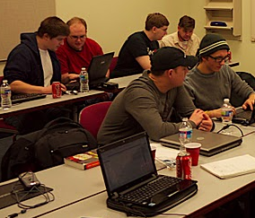
Now students wanna use LISP?
Trace elements
of LISP detected
http://tinyurl.com/ai-and-games

Slide 17
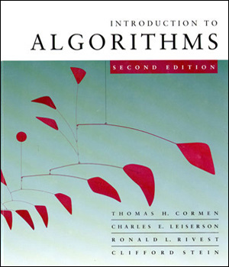
Another view of education
Book1:
  Comprehensive
  coverage of a field
  E.g. Cormen et al.
Book2
  Motivator
  Come on in, the water’s fine
  Samples the ocean, one toe at a time
  Leaves you thirsty for more
http://tinyurl.com/ai-and-games

Slide 18

Pretty soon, they are ready for deep water
Its amazing what people can learn
  When its fun.
  When they don’t realize they are “learning”
http://tinyurl.com/ai-and-games

Slide 19
Four projects, 3 weeks each
LISP intro (chapters 1,2,3,4,5)
Graph search (chapters 6,7,8 )
  extending grand theft wumpus
    If you die, your body explodes and stinks up the neighborhood
    Modify search so that next searcher surfs away from stink
3. Genetic algorithms (chapters 9,10)
  Add a second sex to the evolution game
The rest (10+)
  Students choose
http://tinyurl.com/ai-and-games

Slide 20

More resources
On-line at WVU Safari on-line
The rock video (3 mins long):
  http://goo.gl/dmzv
The author’s overview of the book (80 mins)
  http://goo.gl/nKg5m
  Set in week 1 as a homework assignment
  Tested in a spot quiz
Paul Graham:
  Ansi common LISP
  Excellent desk reference to LISP
Peter Seibel
  Practical Common LISP
  LISP for industrial hackers
http://tinyurl.com/ai-and-games

Slide 21

What have I learned?
Have we made education boring?
  Probably
Can we do better?
  You betcha
http://tinyurl.com/ai-and-games

Slide 22
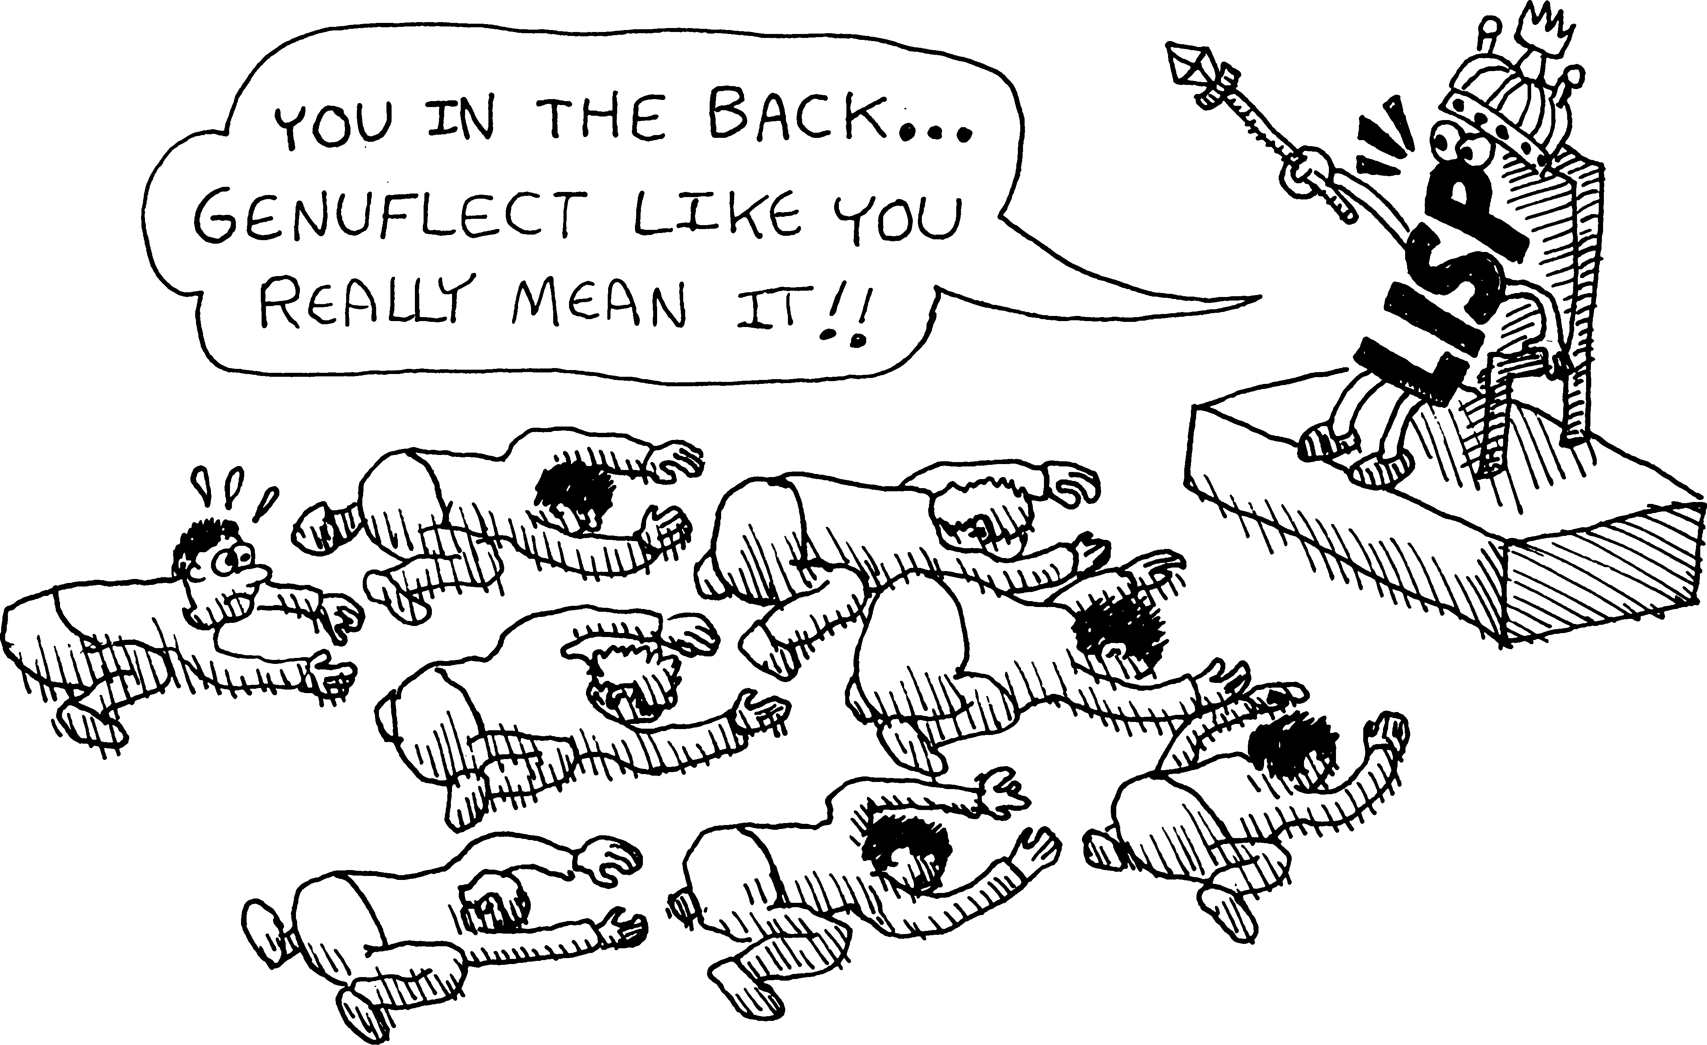
LOL= mad keen fun
http://tinyurl.com/ai-and-games

