Slide 1
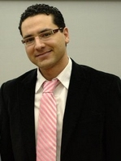
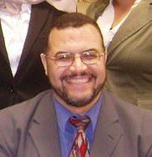


AI & Testing
Marouane Lessentini kessentiniglp@yahoo.fr
Mohamed Kholief kholief@gmail.com
Tim Menzies tim@menzies.us
Mohamed Shaheen cshaheen@hotmail.com

Slide 2
Overview
Inference-based (Tim)
Fuzzy-based, search-based (Mohamed K)
??-based (Morouane)
Other topics (Mohamed S)

Slide 3
Tim: Inference-based AI
KBS-based testing:
  Much talk in the 1980s, 1990s
  In retrospect, its mostly about verification of rule-based expert systems.
  Current high-water mark in that is a tool for maximizing test case coverage after every edit to the rule-based
    http://goo.gl/K565J
AI planners to generate test cases (Smith & Feather) : http://goo.gl/fXUxI
Runtime testing (a.k.a. intelligence vehcile health management) e.g.
  Schumann http://goo.gl/oUNmW

Slide 4
Marouane: ??
Test cases generation from meta-models (How test cases can cover the meta-models? Mutation testing, stress testing…
  Sequence mining to generate testing (Xie)
    http://goo.gl/r3XW5
    eXpress: Guided Path Exploration for Regression Test Generation
Oracle function definitions for transformation testing (how to detect transformation errors : some missing elements in the meta-models, incoherent rules...)

Slide 5
Mohamed Kholief: search-based, fuzzy-based
fuzzy models in software testing.
SBSE: A Systematic Review of the Application and Empirical Investigation of Search-Based Test Case Generation http://goo.gl/OBHv6
    E.g. GAs to organize testing (Andrews & Menzies) http://goo.gl/8yUqC

Slide 6
Mohamed Shaheen :
Other topics:
What have we missed?
  http://goo.gl/cJSh8

